Slide 1

ECE 594Q / CS 280
Introduction to Computer Graphics
Pradeep Sen
UCSB MIRAGE Lab

Slide 2
Part II
The Real-time Rendering Pipeline

Slide 3
Introduction
We’re now ready to cover one of the first key topics of this class: the real-time rendering pipeline
Essentially, we will study how polygons drawn by the application end up as pixels on the screen

Slide 4
The real-time rendering pipeline
Application
CPU
Command
Vertex
Inside the GPU
Rasterization
Fragment
Framebuffer
Display
Computer Screen

Slide 5
The GPU
The “Graphics Processing Unit” (GPU)
It’s a massively-parallel processor specialized for graphics (although nowadays it’s often used for other things)
This is going to be the computing muscle that makes real-time, interactive graphics possible on your personal computer
It takes in scene information from the CPU, outputs the rendered image to the screen

Slide 6
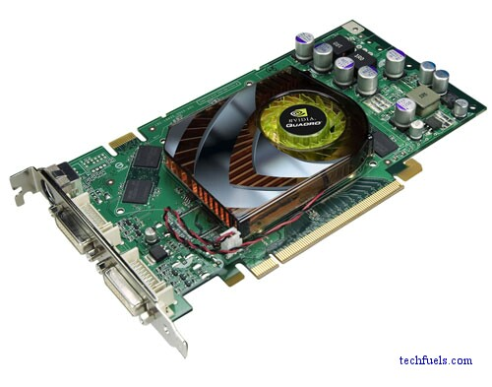
A modern graphics board
The actual GPU (under heatsink/fan)
PCI Express connection to CPU
Connector to monitor
An NVIDIA Graphics Card

Slide 7
The real-time rendering pipeline
Application
CPU
Command
Vertex
Inside the GPU
Rasterization
Fragment
Framebuffer
Display
Computer Screen

Slide 8
Notes
There are many versions of the 3-D real-time rendering pipeline
We’re just using one that suits our needs for this class

Slide 9
A Quick Overview of the Real-time Rendering Pipeline

Slide 10
The real-time rendering pipeline
Application
The application:
Runs the game (keeps the state, collision detection, etc.)
Controls the enemy AI
Handles user input
Determines where the user is and what they are looking at
Sets the state of the graphics hardware before drawing
Once ready, it sends geometry to the graphics card for rendering
Communicates with the graphics hardware through a graphics API such as OpenGL or DirectX
Command
Vertex
Rasterization
Fragment
Framebuffer
Display

Slide 11
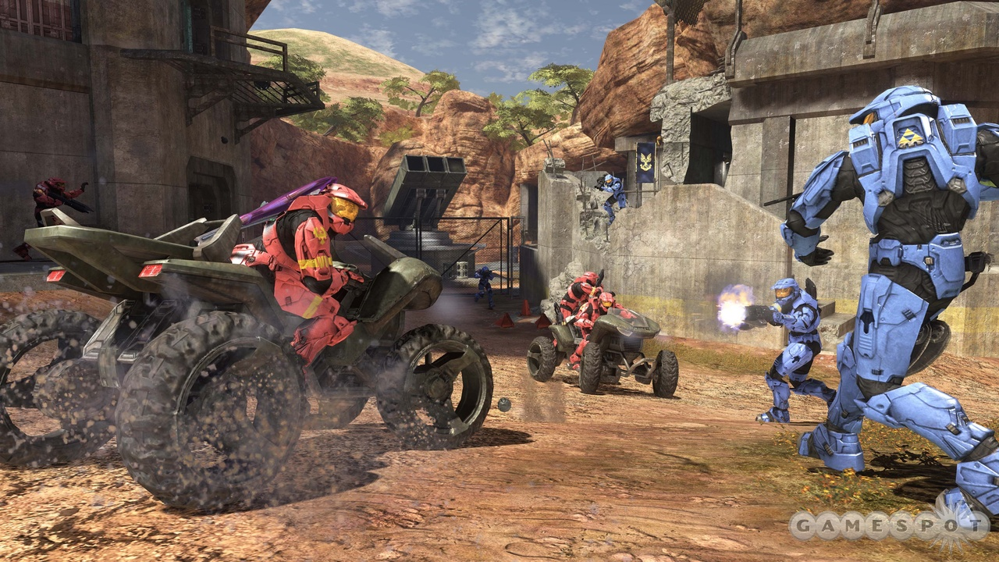
Sample application
Halo 3 – Bungie (2009)

Slide 12
Applications
The application does a lot of things we are not going to talk about in this class
Maintain data structures
Handle user input
File I/O
Artificial intelligence
Networking
We are only going to focus on the graphics aspects of the main application

Slide 13
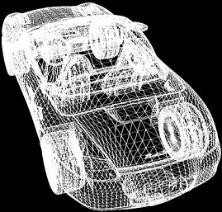
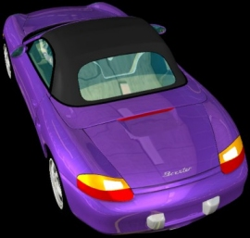
Representing geometry
In real-time graphics, geometry is typically represented by triangles
The GPU must then draw these triangles to the screen

Slide 14
Specifying triangles
A triangle can be specified with three vertices v₁, v₂, v₃
v₁
= (x₁, y₁, z₁)
v₂
= (x₂, y₂, z₂)
v₃
= (x₃, y₃, z₃)

Slide 15
Things the app wants to tell the GPU
The geometry of the scene
The position of light sources
The position and orientation of the viewer
Shaders/textures that will be used in the scene
etc.

Slide 16
Talking to the GPU
The communication with the GPU typically happens through a high-level graphics API such as OpenGL or DirectX
We will start talking about the OpenGL API later in this lecture…

Slide 17
The real-time rendering pipeline
Application
The command stage:
Parses the input from the CPU
Sets up the hardware for rendering
Command
Vertex
Rasterization
Fragment
Framebuffer
Display

Slide 18
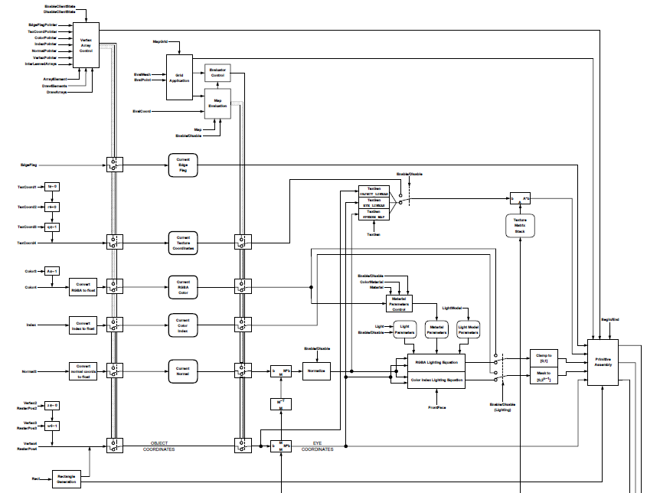
The GPU as a state machine
Part of the graphics state machine as exposed by OpenGL

Slide 19
The real-time rendering pipeline
Application
The vertex stage:
Transforms the vertices of the scene triangles to position them correctly on the screen
This includes animation, perspective projection, etc.
Some programmable per-vertex shading can be done here
When triangles leave this stage, they have been transformed to clip-space coordinates and are ready for clipping and rasterization
Command
Vertex
Rasterization
Fragment
Framebuffer
Display

Slide 20
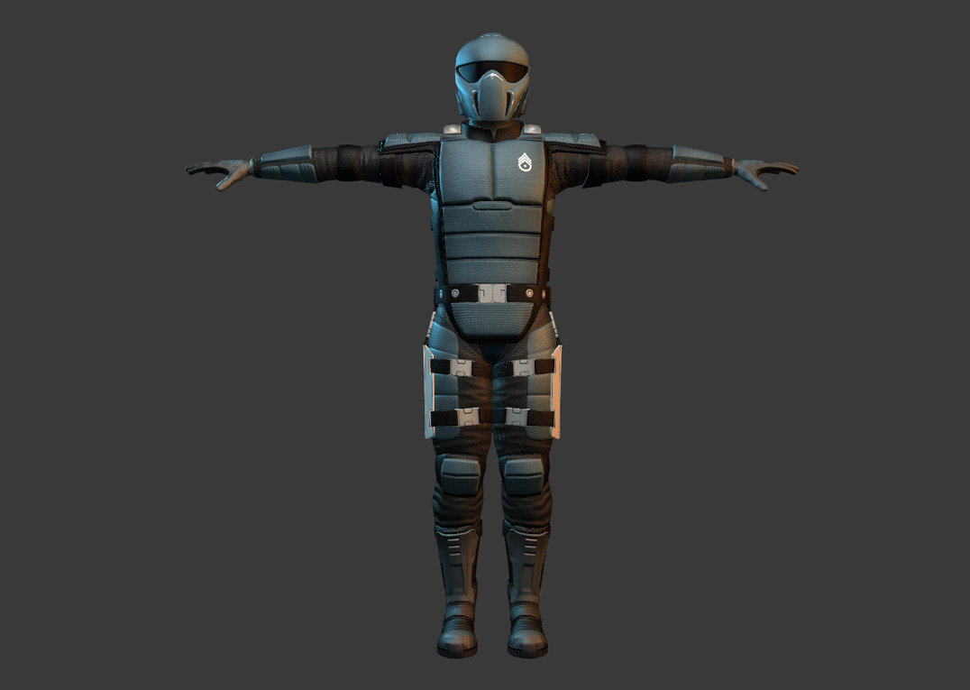
The Model Transform
Models are often composed of triangles defined in local object coordinates
v₁ = (0.251, -0.123, 1.67)
v₂ = (0.243, 0.05, 1.62)
v₃ = (0.241, -0.095, 1.57)
z
y
x
Image credit: interstellarmarines.com

Slide 21
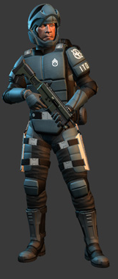
The Model Transform
As the model moves around the world, the vertices that make it up will also move
z
y
x
Image credit: interstellarmarines.com

Slide 22
The Model Transform
The CPU could update the position of each these vertices… but that’s a lot of work!
You would need to loop over all the vertices in the scene to update them
That’s what the GPU is for!
The GPU will use the movement of the object to compute the vertices in world coordinates
This is known as the model transform
After we have done this, the vertices are now in world space coordinates

Slide 23
The View Transform
We now need to move the objects so that the camera (the viewer) is at the center of the world
This makes a lot of the viewing calculations much easier
This is known as the view transform

Slide 24
The View Transform
world space
y
x

Slide 25
The View Transform
world space
y
y
x
x
x
z
eye translated to origin
eye space

Slide 26
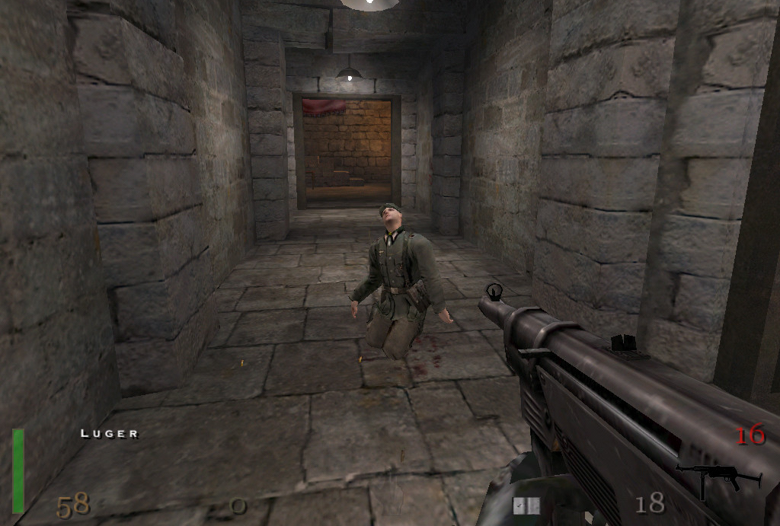
The View Transform
At the end of this stage, everything should be lined up to the screen
We need to account for perspective projection
Return to Castle Wolfenstein – id (2001)

Slide 27
Kinds of projection
Orthographic projection
Perspective projection

Slide 28
Perspective projection
perspective
projection
x
-1
1
x
z
z
eye space

Slide 29
The real-time rendering pipeline
Application
The rasterization stage:
Also known as “scan conversion”
Here the geometry is transformed into pixels (sampling)
First, triangles are clipped if they stick out of the screen
Then they are perspectively mapped to the screen (with homogeneous divide)
Pixels (fragments) inside triangles are then output by the rasterizer
It also interpolates per-vertex parameters at every fragment
Command
Vertex
Rasterization
Fragment
Framebuffer
Display

Slide 30
Triangle Clipping
The goal is to cut out pieces of triangles that stick out of the screen
This is not only an optimization strategy, it leads to correct results

Slide 31
Triangle Clipping

Slide 32
Rasterization
Turn the triangle from a vertex representation to a pixel representation

Slide 33
Rasterization

Slide 34
The real-time rendering pipeline
Application
The fragment stage:
Fragments are “pixels in flight” in the pipeline – they have more information than a typical pixel (color, depth, texture coords, etc.)
The fragment stage performs operations on these fragments like shading/texturing them
Modern GPU’s offer user-defined programmability at this stage
After this stage, the fragments are ready to become pixels in the framebuffer
Command
Vertex
Rasterization
Fragment
Framebuffer
Display

Slide 35
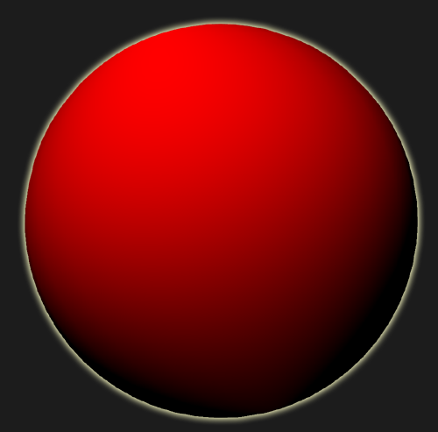

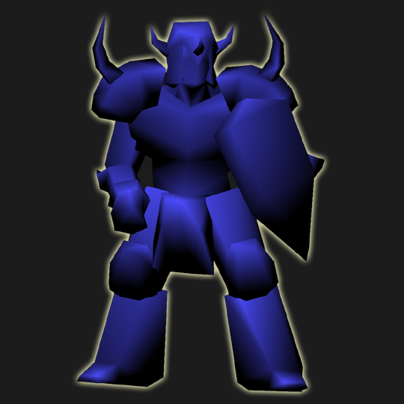
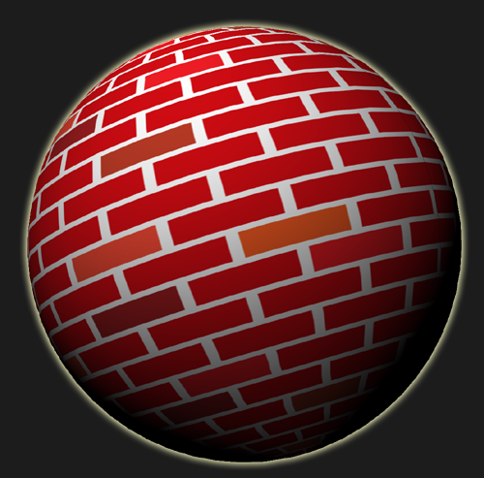
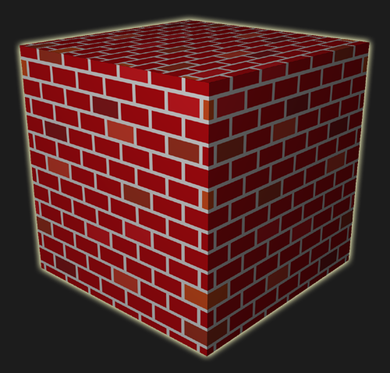
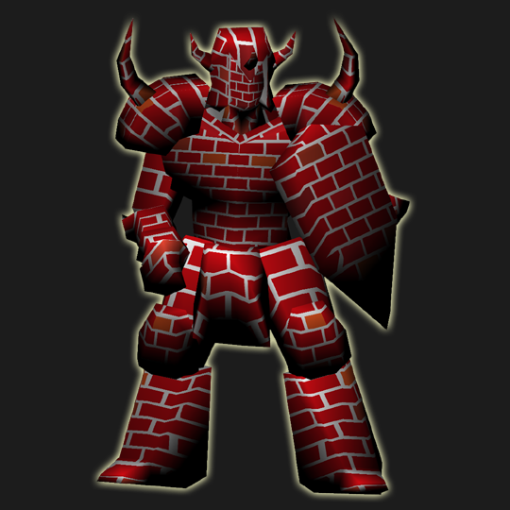
Texturing
standard geometry
texture-mapped geometry

Slide 36
The real-time rendering pipeline
Application
The framebuffer stage:
Not all triangles should be visible on the screen… the framebuffer does important tests to check for visibility (e.g., depth test)
Other tests can also be done at this stage (stencil, alpha, etc.)
Blending and other effects can also be performed
The framebuffer memory is directly connected to D/A converters that send the signal to the display
Command
Vertex
Rasterization
Fragment
Framebuffer
Display

Slide 37
The real-time rendering pipeline
Application
The display stage:
D/A converters scan out the framebuffer memory and send it to the display
This is the part that everyone sees – without display there is no computer graphics!
Command
Vertex
Rasterization
Fragment
Framebuffer
Display

Slide 38
In-depth: the Real-time Rendering Pipeline

Slide 39
The Application Stage

Slide 40
The graphics pipeline
Application
Command
Vertex
Rasterization
Fragment
Framebuffer
Display

Slide 41
Application Stage
The application needs a way to communicate “graphics stuff” to the GPU
This is usually done using a standard, real-time graphics API, such as OpenGL or DirectX
Universities typically have used OpenGL (more portable), industry often used DirectX (Microsoft API)
In this class, we’ll use OpenGL

Slide 42
OpenGL
OpenGL is an API for 3-D graphics
Platform independent
It gives us a language to “talk” to the hardware and tell it what we want it to do

Slide 43
OpenGL State Machine
Programming OpenGL is like programming a state machine:
Set up the state
Push through the geometry
The API provides functions for us to do this

Slide 44
Two kinds of functions
There are 2 kinds of OpenGL functions:
State changing
Transformations
Attributes
Primitive generating
Is what results in the drawing of an object to the screen
The appearance is controlled by the state that has been set

Slide 45
Drawing primitives
There are three ways to draw primitives using OpenGL
These range from simplest (inefficient) to highly optimized (but more cumbersome to write)
So usually when starting out, it’s best to start with the simplest way: immediate mode

Slide 46
1. Immediate mode
Use glBegin() to tell it what sort of primitive to build
e.g.
glBegin(GL_POLYGON);
glBegin(GL_TRIANGLES);
glBegin(GL_LINES);

Slide 47
Immediate mode vertices
glVertex*() – Issues a vertex to the hardware
glColor*() – Issues a color that will be bound to that vertex
glTexCoord*() – Issues a texture coordinate for that vertex

Slide 48
Information at each vertex
Position
Color
Texture coordinates
Normals
etc.

Slide 49
Example – Immediate Mode
Draws a quad at these four coordinates
void drawPolygon(void) {
glBegin(GL_POLYGON);
glVertex2f(0.0, 0.0);
glVertex2f(0.0, 3.0);
glVertex2f(4.0, 2.0);
glVertex2f(-1.0, 1.0);
glEnd();
}

Slide 50
Example – Immediate Mode
Now change color at each corner
void drawPolygon2(void) {
glBegin(GL_POLYGON);
glColor3f(1.0, 0.0, 0.0);
glVertex2f(0.0, 0.0);
glColor3f(0.0, 1.0, 0.0);
glVertex2f(0.0, 3.0);
glColor3f(1.0, 0.0, 1.0);
glVertex2f(4.0, 2.0);
glColor3f(1.0, 1.0, 0.0);
glVertex2f(-1.0, 1.0);
glEnd();
}

Slide 51
2. Vertex Arrays
Instead of specifying the data one vertex at a time), you can specify them more quickly using vertex arrays
glVertexArrayPointer()
glColorPointer()
glTexCoordPointer()
glDrawArrays()
Etc.

Slide 52
Example – Vertex Arrays
typedef float vector2[2];
typedef float vector3[3];
static vector2 vertices[] = {
{0.0, 0.0},
{0.0, 3.0},
{4.0, 2.0},
{-1.0, 1.0},
};
static vector3 colors[] = {
{1.0, 0.0, 0.0},
{0.0, 1.0, 0.0},
{1.0, 0.0, 1.0},
{1.0, 1.0, 0.0},
};
void drawPolygon3(void) {
glEnableClientState(GL_VERTEX_ARRAY);
glEnableClientState(GL_COLOR_ARRAY);
glVertexPointer(2, GL_FLOAT, 0, vertices);
glColorPointer(3, GL_FLOAT, 0, colors);
glDrawArrays(GL_POLYGON, 0, 4);
glDisableClientState(GL_VERTEX_ARRAY);
glDisableClientState(GL_COLOR_ARRAY);
}

Slide 53
3. Vertex Buffer Objects (VBOs)
Although vertex arrays are more efficient than inputting each vertex with a separate call, it still needs to send all vertices at every frame
We need the ability to “lock” the vertices that we’re not going to touch and sent them to the GPU only once
This is why we have Vertex Buffer Objects (VBOs)
Idea: send vertex data to GPU once before drawing starts
Data sits in GPU memory while drawing all frames

Slide 54
Example – Vertex Buffer Objects (VBOs)
void loadPolygon (void) {
/* create vertex buffer */
GLuint vertices_vbo = 0;
glGenBuffers(1, & vertices_vbo );
glBindBuffer(GL_ARRAY_BUFFER, vertices_vbo );
glBufferData(GL_ARRAY_BUFFER, 8 * sizeof(float), vertices, GL_STATIC_DRAW);
/* create color buffer */
GLuint colors_vbo = 0;
glGenBuffers(1, & colors_vbo);
glBindBuffer(GL_ARRAY_BUFFER, colors_vbo);
glBufferData(GL_ARRAY_BUFFER, 12 * sizeof(float), colors, GL_STATIC_DRAW);
/* create vertex buffer object */
GLuint vao = 0;
glGenVertexArrays(1, &vao);
glBindVertexArray(vao);
glBindBuffer(GL_ARRAY_BUFFER, vertices_vbo);
glVertexAttribPointer(0, 2, GL_FLOAT, GL_FALSE, 0, NULL);
glBindBuffer(GL_ARRAY_BUFFER, colors_vbo);
glVertexAttribPointer(1, 3, GL_FLOAT, GL_FALSE, 0, NULL);
}

Slide 55
Example – Vertex Buffer Objects (VBOs)
void drawPolygon4(void) {
/* create vertex buffer */
glUseProgram(my_shader);
glBindVertexArray(vao);
glDrawArrays(GL_POLYGON, 0, 3);
}
And this needs vertex and fragment shaders:
Vertex shader
Fragment shader
layout(location = 0) in vec2 vertex_position;
layout(location = 1) in vec3 vertex_color;
out vec3 color;
void main() {
color = vertex_color;
gl_Position = vec4(vertex_position, 0.0, 1.0);
}
in vec3 color;
out vec4 frag_color;
void main() {
frag_color = vec4(color, 1.0);
}

Slide 56
Texturing surfaces
To texture surfaces, you need to provide:
Texture coordinates on the vertices
Will be interpolated by the rasterizer at every fragment
A texture ID
Created using glGenTextures(). Example: glGenTextures(1, &texture);
And bind it to the texture unit before drawing: glBindTexture(GL_TEXTURE_2D, texture);
A bitmap for the texture
Loaded using glTexImage2D(). Example:
glTexImage2D(GL_TEXTURE_2D, 0, GL_RGB, width, height, 0, GL_RGB, GL_UNSIGNED_BYTE, data);

Slide 57
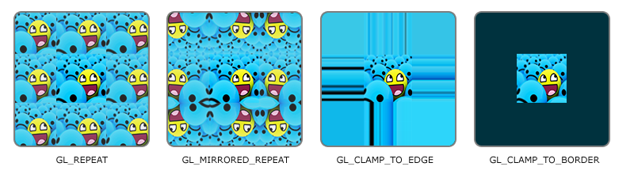
Texturing surfaces (cont)
You can also specify:
What happens when texture coordinates are extrapolated. E.g.,
glTexParameteri(GL_TEXTURE_2D, GL_TEXTURE_WRAP_S, GL_REPEAT);
This REPEATS the texture in the s coordinate
You can also do GL_MIRRORED_REPEAT, GL_CLAMP_TO_EDGE, GL_CLAMP_TO_BORDER

Slide 58
Texturing surfaces (cont)
You can also specify:
What happens when texture coordinates are extrapolated.
How the texture is magnified/minified. E.g.,
glTexParameteri(GL_TEXTURE_2D, GL_TEXTURE_MIN_FILTER, GL_NEAREST);
glTexParameteri(GL_TEXTURE_2D, GL_TEXTURE_MAG_FILTER, GL_LINEAR);
For minimization, you can specify mipmaps for antialiasing (more on that later)

Slide 59
GLU
The OpenGL Utility Library (GLU) has lots of nice built-in commands
Saves you from having to rewrite code
For example, a convenient function for setting the perspective matrix:
void gluPerspective(float fovy, float aspect, float zNear, float zFar);

Slide 60
The Command Stage

Slide 61
The graphics pipeline
Application
Command
Vertex
Rasterization
Fragment
Framebuffer
Display

Slide 62
The command stage
Implemented between the driver and the graphics card
Sets up the state of the hardware in preparation for rendering
Not much to talk about in terms of algorithms

Slide 63
The Vertex Stage

Slide 64
The graphics pipeline
Application
Command
Vertex
Rasterization
Fragment
Framebuffer
Display

Slide 65
Vertex Stage
The vertex stage can be thought of as applying two different transformations:
1) The modelview transformation
2) The projection transformation
We will look at each in turn…

Slide 66
Modelview transformations

Slide 67
The modelview transformation
The modelview transformation needs to transform the vertices from model space to eye space
But first we need to understand how transformations work
We begin with 2-D transformations…

Slide 68
2-D Transformations
Scaling
Rotation (see derivation)
Translation – How do you do it as a linear operation?
Answer: homogenous coordinates

Slide 69
Homogeneous coordinates

Slide 70
3-D Transformations

Slide 71
The matrix stack

Slide 72
The order of the transformations
The order in which the transformations are executed matters a lot!

Slide 73
Transforming normals
Normals cannot be transformed by the modelview matrix directly
They may no longer be normal to the surface that has been transformed!
Instead we must multiply normal by the inverse transpose of the modelview matrix
Derivation…

Slide 74
Transformed vertices are now in eye space
world space
y
y
x
x
x
z
eye space

Slide 75
Projection transformations

Slide 76
Projection transformation
The goal is to map a chunk of volume in eye space to the canonical view volume, defined by the axis-aligned cube with sides at +/- 1
y
+1
x
+1
+1
z
canonical view volume

Slide 77
Projections
There are two main kinds of projective transformations:
Orthographic
Perspective

Slide 78
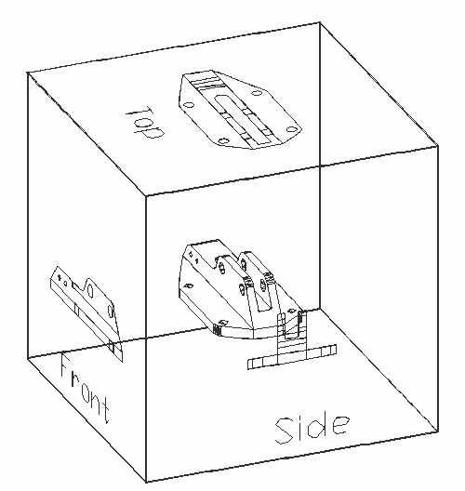
Orthographic projection
Often used in CAD

Slide 79
Orthographic projection
Derivation of the orthographic projection matrix

Slide 80
Perspective projection
Orthographic projection did not depict the scene as perceived by an individual
The Renaissance introduced a new way of thinking: the power of the individual
Desire to represent the world as experienced by an individual, not an all-seeing god.
Missing in much of the artwork that was not influenced by the Renaissance…

Slide 81
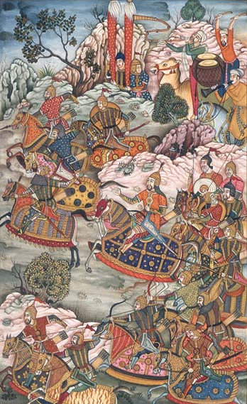
Eastern art at the time of the renaissance
Baburnama (1530)

Slide 82
Development of perspective projection
During the Renaissance, perspective projection came about as a way of representing the individual’s view point

Slide 83
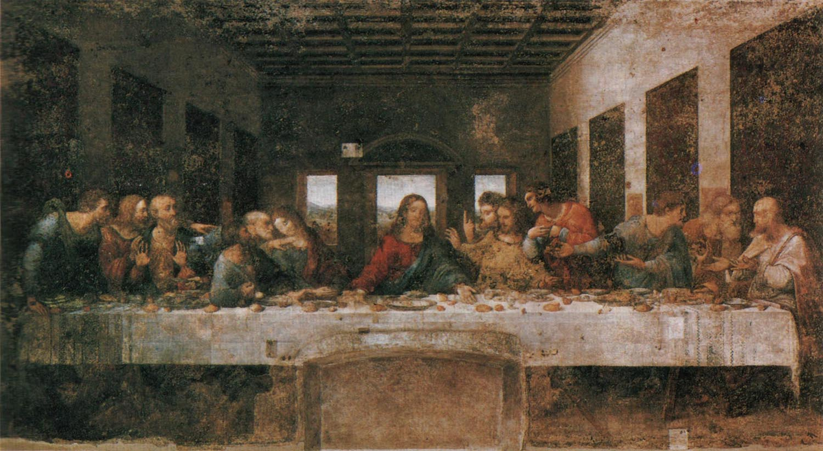
The Last Supper
The Last Supper - Leonardo DaVinci (1495 – 1498)

Slide 84
Perspective Projection
Derivation of perspective matrix

Slide 85
At the end of the vertex stage
At this point, if we haven’t done the perspective divide the vertices are in clip-space coordinates
Now we move into the next stage, which sets up the triangles for rasterization and generates the fragments for each triangle

Slide 86
Clipping and Rasterization

Slide 87
The graphics pipeline
Application
Command
Vertex
Rasterization
Fragment
Framebuffer
Display

Slide 88
Clipping algorithm
Naïve:
Do it while rasterizing!
Rasterize the entire triangle, reject the fragment if it is outside the window
This is essentially scissoring, which we will talk about later…
You waste a lot of time rasterizing fragments that don’t end up in the screen
Also, you will incorrectly rasterize things that are behind the viewer, because those will appear in front of the viewer after the perspective divide

Slide 89
Clipping after perspective divide
Demonstration of the problems that occur here

Slide 90
Clipping algorithm
More sophisticated:
We need to clip before we perform the perspective divide (in clip-space)
Variation of Sutherland-Hodgman polygon clipping algorithm
Clip triangle against each edge in turn to create new triangles.
Clip these against other edges…

Slide 91
Equations for clipping
How to clip before the homogenous divide
Derivation…

Slide 92
Triangle Clipping Algorithm

Slide 93
Triangle Clipping Algorithm

Slide 94
Triangle Clipping Algorithm

Slide 95
Triangle Clipping Algorithm

Slide 96
Triangle Clipping Algorithm

Slide 97
Triangle Clipping Algorithm

Slide 98
Viewport transformation
Take vertices that are -1 to 1 and map them to 0 to screen width - 1 and 0 to screen height - 1 for x and y respectively

Slide 99
Coordinate spaces
object space coordinates
coordinates of the vertices of the objects
Modelview matrix
eye space coordinates
eye at origin, facing –z, +x is right, +y is up
Projection matrix
clip-space coordinates
vertices are now (x_{c}, y_{c}, z_{c}, w_{c})
Clipping
Homogenize
normalized device coordinates (NDC)
all vertices are now from -1 to 1
Viewport Transform
vertices are now:
0 < x < screen width
0 < y < screen height
screen-space coordinates
Rasterization

Slide 100
The Rasterization Stage

Slide 101
The graphics pipeline
Application
Command
Vertex
Rasterization
Fragment
Framebuffer
Display

Slide 102
Rasterization
The goal of rasterization is to transform the mathematical representation of a triangle and convert it into a set of pixels lit on the screen

Slide 103
Rasterization

Slide 104
Rasterization
There are two problems the rasterizer must solve:
1) Determine which pixels are “touched” by the triangle (fragment generation)
2) Determine the value of interpolants at each of these pixel positions (interpolation)

Slide 105
Rasterization
Conversion from floating point screen space coordinates into integer pixel coordinates on the screen

Slide 106
Bounding box algorithm
box
y_max
y_min
x_min
x_max
void rasterizeTriangle(void) {
for (y = y_min; y < y_max; y++) {
for (x = x_min; x < x_max; x++) {
if insideTriangle(x,y) {
generateFragment(x,y);
}
}
}
}

Slide 107
Inside tests
v0
v1
v2
The sample is “inside” the triangle if it is on the inside of all three line sidedness tests
But how do we determine what side of a line a point is on?

Slide 108
Line sidedness tests
Test to see which side of a line a point is on
Express the line as the cross product of the end points
Perform a dot product against the line equation to determine sidedness
Positive one side, negative other, zero means it’s on the line
Make sure you are consistent about the order the vertices are processed

Slide 109
Inside tests
void lineEquation(float *v0, float *v1, float *f){
crossProduct(v1, v0, f);
}
bool insideTriangle(int x,y) {
lineEquation(v0, v1, &f0);
lineEquation(v1, v2, &f1);
lineEquation(v2, v0, &f2);
Pt p(x,y,1);
if ((dotProduct(p, f0) > 0) &&
(dotProduct(p, f1) > 0) &&
(dotProduct(p, f2) > 0) {
// inside the triangle
return true;
}
return false;
}

Slide 110
Inside tests
To accelerate things, you can make it incremental:
void rasterizeTriangle(void) {
// compute line equations f0,f1,f2 as before
Pt p(x_min, y_min, 1);
e0 = dotProduct(p,f0);
e1 = dotProduct(p,f1);
e2 = dotProduct(p,f2);
for (y = y_min; y < y_max; y++) {
for (x = x_min; x < x_max; x++) {
if (e0 >= 0) && (e1 >= 0) && (e2 >= 0) {
generateFragment(x,y);
}
e0 += f0.i; e1 += f1.i; e2 += f2.i;
}
e0 += -(x_max – x_min)* f0.i + f0.j;
e1 += -(x_max – x_min)* f1.i + f1.j;
e2 += -(x_max – x_min)* f2.i + f2.j;
}
}

Slide 111
Boundary cases
We need to prevent double counting of pixels on triangle boundaries
This is important for transparency, CSG, and efficiency
Let’s first look at a few wrong ways to handle it

Slide 112
Incorrect solution #1
Ignore the condition and double rasterize
Imagine we are rendering semi-transparent triangles:

Slide 113
Incorrect solution #2
Set the inside test to ‘>’ to ignore samples that lie exactly on the line edge
No two triangles will “touch” the same pixels unless they overlap, in which case you want to rasterize both anyway
Problem:

Slide 114
Shadow test
Modify our line side test…
bool insideLine(float e) {
return (e >= 0);
}
bool insideLine(float e, float *f) {
return (e == 0) ? shadowTest(f) : (e > 0);
}
bool shadowTest(float *f) {
return (f.i == 0) ? (f.j > 0) : (f.i > 0);
}

Slide 115
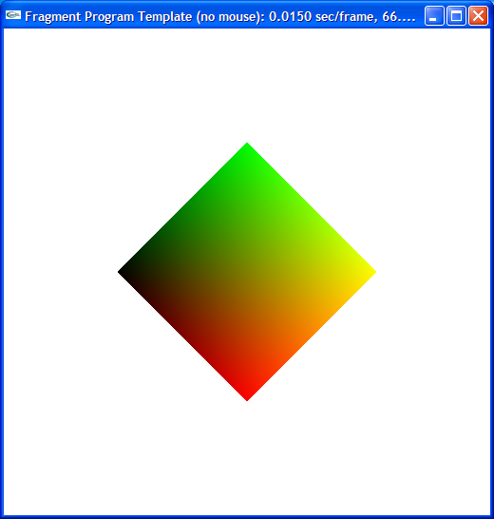
What about shading?
So now we have a simple way to determine which pixels are on.
Now how do we color the pixel?
0,1,0
0,0,0
1,1,0
1,0,0

Slide 116
Interpolation
Want to represent a function over the surface of the triangle
Many ways to do this…
Graphics hardware does it implicitly from the values at the corners of the triangle

Slide 117

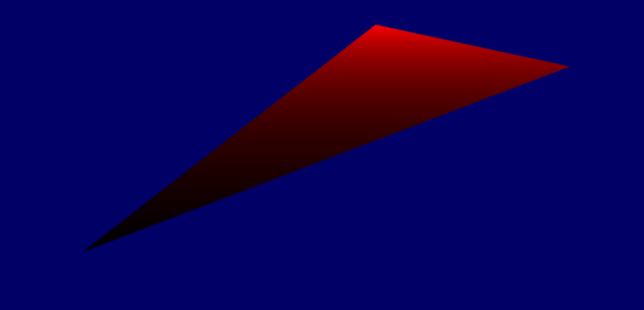
Interpolation
1,0,0
Red channel “height field”
1
0.5,0,0
0.5
0
0,0,0

Slide 118
How do you compute this plane?
Equation of a plane
e1 x e2
e1
e2
1
0.5
P
0

Slide 119
Barycentric coordinates
v1
P = (A₀/A) v0 + (A₁/A) v1 + (A₂/A) v2
P = α₀ v0 + α₁ v1 + α₂ v2
A₂
α₀ + α₁ + α₂ = 1
A₀
P
(A₀/A) + (A₁/A) + (A₂/A) = 1
v0
A₁
Remember: this is done in screen space!
v2

Slide 120
Interpolants
You can interpolate:
Colors (typically 4 – red, green, blue, alpha)
Depth (1)
Normals (3)
Texture coordinates (1,2,3)
etc.

Slide 121
Status
So now we have an algorithm that goes through the bounding box and determines which pixels should be rasterized by the triangle
Then we must work out the interpolated value separately for each pixel
Very inefficient…

Slide 122
Edge-walking rasterization
v1
Δx
Δy
Δz/Δx
end
v0
start
v2

Slide 123
Edge-walking rasterization
v1
v0
start
Δy
Δx
end
v2

Slide 124
Triangle rasterization algorithm
void rasterizeTriangle(void) {
// sort vertices in order of descending y
// identify scanlines of first half of the triangle
// compute screen-space derivatives along edges
for each scanline {
// find span by interpolating vertex coordinates
// find start and end values for interpolants
// (color, depth, texture coordinates)
// rasterize span
for each pixel in span {
// interpolate color, depth, texture coords
// shade pixel
// perform depth buffering
}
}
// repeat for the second half of the triangle
}

Slide 125
Acceleration
Digital Differential Analyzer (DDA)
Represent slope and accumulation with fixed point
Have to be careful to avoid overflow
Homogeneous recursive descent
Used in modern GPU’s

Slide 126
Perspective-correct interpolation
perspective correct
perspective incorrect

Slide 127
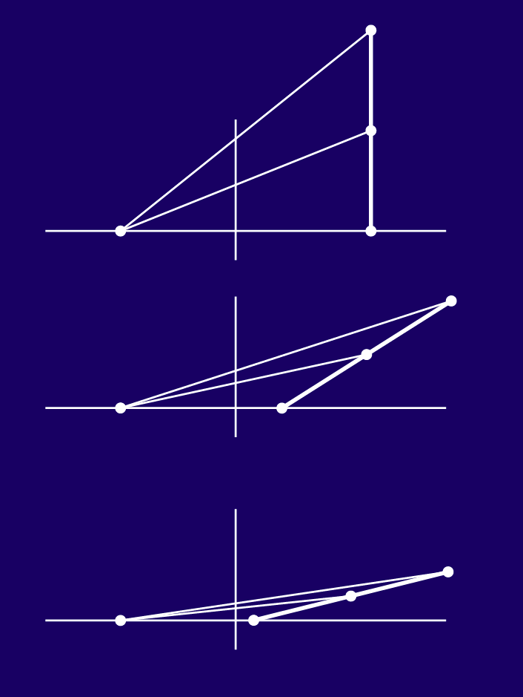
Perspective-correct interpolation

Slide 128
Solution
Project all interpolants first by dividing by w
Interpolate interpolants as well as 1/w
Get original value back by multiplying by interpolated w

Slide 129
Once fragments are rasterized
They can be shaded (colored)
Through a texture map
Through a fragment program

Slide 130
The Fragment Stage

Slide 131
The graphics pipeline
Application
Command
Vertex
Rasterization
Fragment
Framebuffer
Display

Slide 132
The fragment stage
After the rasterization stage, we now have a set of fragments that have been generated for the input triangle
These fragments must be colored (or shaded) and then sent on to the framebuffer stage
The fragment processor does this, working on each fragment independently and in parallel

Slide 133
Different ways to color a fragment
Use a fixed color (constant color triangles – boring!)
Use an interpolated color (slightly better)
Use a texture map (more realistic!)
Execute an arbitrary user-defined program (most flexible!)

Slide 134
Texture mapping
Simple way of shading the fragment to give it a more “realistic” appearance

Slide 135
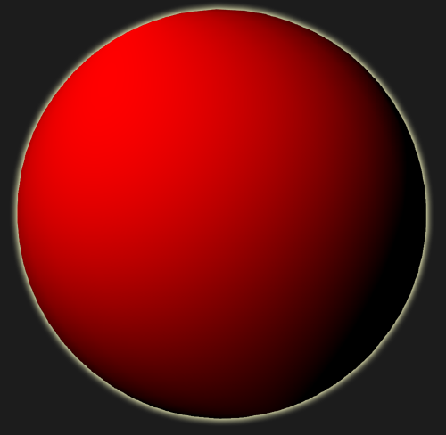
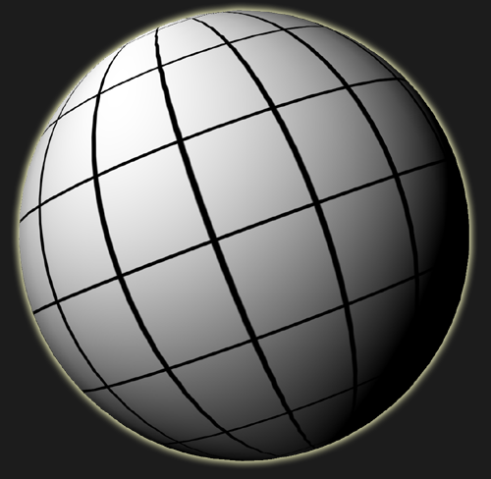
Introduction to texture mapping
Developed by Catmull (’74) as way to improve realism without increasing geometric complexity
Define parameterization (u,v) over surface
Function f(u,v) can now modify appearance of surface
Function f(u,v) can be stored as an array of pixels called a texture
v
v
(u₀,v₀)
(u₀,v₀)
u
u
geometry
u,v parameterization
f(u,v)

Slide 136
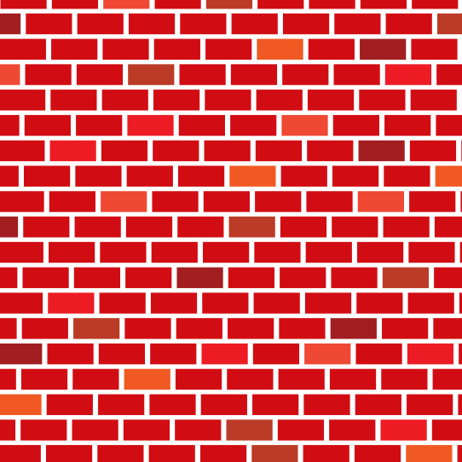
Introduction to texture mapping
v
geometry
texture
u
texture-mapped

Slide 137


Representing Theoretical Texture Signal
There are several possible ways to represent the theoretical texture signal:
Explicitly, with a mathematical equation
v
e.g. f(u,v) = sin(10π u v)
u
Unfortunately, it is difficult to generalize this approach…
v
What is the equation for this?
u

Slide 138
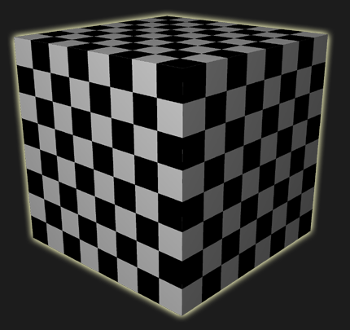
Representing Theoretical Texture Signal
There are several possible ways to represent the theoretical texture signal:
Explicitly, with a mathematical equation
Implicitly, with a functional program that can compute f(u,v) everywhere on the domain
e.g. procedural textures
Shader checkboard(float4 uv) {
uv = floor(uv * 8);
return ((uv.x % 2) == (uv.y % 2));
}
These have the same problem as the explicit representations – not all textures can be represented!

Slide 139
Representing Theoretical Texture Signal
There are several possible ways to represent the theoretical texture signal:
Explicitly, with a mathematical equation
Implicitly, with a functional program that can compute f(u,v) everywhere on the domain
Implicitly, with a composition of geometrical shapes with well-defined mathematical representations.
e.g. vector graphics
These can be expensive to compute in real-time. Similar to the general rendering problem!

Slide 140

Representing Theoretical Texture Signal
There are several possible ways to represent the theoretical texture signal:
Explicitly, with a mathematical equation
Implicitly, with a functional program that can compute f(u,v) everywhere on the domain
Implicitly, with a composition of geometrical shapes with well-defined mathematical representations.
Approximately, using a discrete representation
v
v
“texture”
u
u
theoretical texture signal
discrete representation

Slide 141
Essentially a lookup table
You want to evaluate function f(s,t) on the surface…
You can store it in an array for fast access
But what happens to the screen samples that do not map directly to the samples of the texture?

Slide 142
Nearest neighbor sampling
Map the point to the 2D array of samples
Take the sample that is closest to the projected point

Slide 143
Bilinear interpolation
Linear reconstruction of the function f(s,t) using neighboring color samples

Slide 144
Texture filtering
Screen space samples are closer together than texture samples (magnification)
OpenGL provides two reconstruction filters: GL_NEAREST, GL_LINEAR
Screen space samples are farther apart than texture samples (minification)
Summed area tables
Mipmapping

Slide 145
Summed area tables

Slide 146




Mipmapping
MIP- multum in parvo (many things in a small place)
Technique in which to perform pre-computed filtering for minification
Space usage 1.3 x more than the standard texture!

Slide 147
Mipmapping
Accessing the mipmap
How do we estimate pixel footprint size?

Slide 148
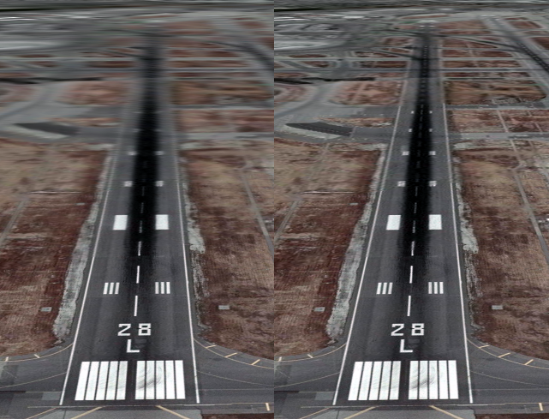
Problems with mipmapping
Decimated textures all have a square footprint (isotropic)
Here, screen samples in the u direction are more dense than in the v direction!
If you choose ds/du for the bias, you will have aliasing in v.
If you select dt/dv for the bias, you will have blurring in u
source: wikipedia
with standard mipmapping

Slide 149
Anisotropic filtering
Approximate the pixel “footprint” with an ellipse
Compute contribution in ellipse through multi-sampling

Slide 150
Fragment processing

Slide 151
Fragment processing
Texture mapping is one way the color of the fragment can be set by the fragment unit
Let’s look at another way this can be done…
The fragment stage can color fragments by executing a user-defined program known as a fragment program
At this point, we should also mention that the vertex stage can be programmed with a vertex program

Slide 152
Programmability
Around the year 2000, the vertex and fragment stages of the graphics pipeline were made programmable
This allowed users to specify their own programs for these stages
Recently other stages have become programmable as well

Slide 153
The programmable graphics pipeline
Application
Command
Vertex
User defined program
Rasterization
Fragment
User defined program
Framebuffer
Display

Slide 154
The old vertex unit
This used to be a fixed function – the user could not change the behavior of the unit
It multiplied every vertex by the MVP matrix (modelview – projection)
It could also do some per-vertex lighting calculations (these are typically done per-pixel now)
It would output the vertices in clip-space for the rasterizer stage

Slide 155
The old fragment unit
It was based on register combiners, which could blend a fixed set of textures together
Very limited customization

Slide 156
Programming these units
You program these units with vertex and fragment programs
These are also known as shaders, but I prefer the more general term “programs”
We will start off by looking at how to program these units in assembly (old school)
Later we will look at high level languages for programming them

Slide 157
Vertex program
Extension GL_ARB_vertex_program
Assembly-like programming style
Ex:
add A, B, C;
opcode
target register
src registers
A = B + C

Slide 158
Vertex program inputs
The inputs to the vertex program are the per-vertex attributes which include:
vertex.position
vertex.weight
vertex.weight[n]
vertex.normal
vertex.color
vertex.fogcoord
vertex.texcoord, unit 0
vertex.texcoord[n], unit n
vertex.attrib[n]
Specified per-vertex by the main OpenGL application

Slide 159
Vertex program outputs
The interpolant outputs of the vertex program (and the inputs to the fragment program) include:
result.position
result.color
result.fogcoord
result.texcoord, unit 0
result.texcoord[n], unit n

Slide 160
A few things to keep in mind
Registers are float4 wide
That’s because the things we are operating on (vertices) typically have four components
You can access all these components individually or together through masking or swizzling
.x
.y
.z
.w

Slide 161
The ALU on the GPU

Slide 162
Swizzling

Slide 163
Masking

Slide 164
Simple vertex program
!!ARBvp1.0
ATTRIB v = vertex.position; # vertex position
# pass in the mvp matrix
PARAM mvp[4] = { state.matrix.mvp };
# define the output
OUTPUT oPos = result.position # output vertex
# transform the vertex v by the mvp matrix
DP4 oPos.x, mvp[0], v;
DP4 oPos.y, mvp[1], v;
DP4 oPos.z, mvp[2], v;
DP4 oPos.w, mvp[3], v;
END

Slide 165
Simple vertex program
!!ARBvp1.0
ATTRIB v = vertex.position; # vertex position
# pass in the mvp matrix
PARAM mvp[4] = { state.matrix.mvp };
# define the output
OUTPUT oPos = result.position # output vertex
# temporaries
TEMP temp;
# transform the vertex v by the mvp matrix
DP4 temp.x, mvp[0], v;
DP4 temp.y, mvp[1], v;
DP4 temp.z, mvp[2], v;
DP4 temp.w, mvp[3], v;
MUL oPos, temp, 9999;
END

Slide 166
Vertex program instruction set
ABS v v absolute value
ADD v,v v add
ARL s a address register load
DP3 v,v ssss 3-component dot product
DP4 v,v ssss 4-component dot product
DPH v,v ssss homogeneous dot product
DST v,v v distance vector
EX2 s ssss exponential base 2
EXP s v exponential base 2 (approximate)
FLR v v floor
FRC v v fraction
LG2 s ssss logarithm base 2
LIT v v compute light coefficients
LOG s v logarithm base 2 (approximate)
MAD v,v,v v multiply and add

Slide 167
Vertex program instruction set
MAX v,v v maximum
MIN v,v v minimum
MOV v v move
MUL v,v v multiply
POW s,s ssss exponentiate
RCP s ssss reciprocal
RSQ s ssss reciprocal square root
SGE v,v v set on greater than or equal
SLT v,v v set on less than
SUB v,v v subtract
SWZ v v extended swizzle
XPD v,v v cross product

Slide 168
Vertex program binding and loading

Slide 169
The programmable graphics pipeline
Application
Command
Vertex
User defined program
Rasterization
Fragment
User defined program
Framebuffer
Display

Slide 170
Fragment program
Often known as “pixel shaders”
Extension GL_ARB_fragment_program
Very similar to vertex programs (in fact identical syntax)
The main goal of the fragment program is to set the color of the fragment

Slide 171
Fragment program inputs
The inputs of the fragment program are the interpolants from the rasterizer
Same list as before (output of vertex program)
Make sure you align the tex coordinate inputs with those output by the vertex unit

Slide 172
Fragment program outputs
There are only two outputs to the fragment program
result.color
result.depth

Slide 173
Simple fragment program
!!ARBfp1.0
MOV result.color, {1, 0, 0, 0};
END

Slide 174
Fragment program instruction set
ABS v v absolute value
ADD v,v v add
CMP v,v,v v compare
COS s ssss cosine with reduction to [-PI,PI]
DP3 v,v ssss 3-component dot product
DP4 v,v ssss 4-component dot product
DPH v,v ssss homogeneous dot product
DST v,v v distance vector
EX2 s ssss exponential base 2
FLR v v floor
FRC v v fraction
KIL v v kill fragment
LG2 s ssss logarithm base 2
LIT v v compute light coefficients
LRP v,v,v v linear interpolation
MAD v,v,v v multiply and add

Slide 175
Fragment program instruction set
MAX v,v v maximum
MIN v,v v minimum
MOV v v move
MUL v,v v multiply
POW s,s ssss exponentiate
RCP s ssss reciprocal
RSQ s ssss reciprocal square root
SCS s ss-- sine/cosine without reduction
SGE v,v v set on greater than or equal
SIN s ssss sine with reduction to [-PI,PI]
SLT v,v v set on less than
SUB v,v v subtract
SWZ v v extended swizzle
TEX v,u,t v texture sample
TXB v,u,t v texture sample with bias
TXP v,u,t v texture sample with projection
XPD v,v v cross product

Slide 176
Higher level languages
RTSL (the first high-level shading language)
Cg (not supported any more by NVIDIA)
GLSL
HLSL

Slide 177
The Framebuffer Stage

Slide 178
The graphics pipeline
Application
Command
Vertex
Rasterization
Fragment
Framebuffer
Display

Slide 179
The framebuffer stage
At this point, the fragments have been shaded and are ready to try to end up in the final framebuffer
The framebuffer stage must decide which fragments will be saved and which ones will be killed because they cannot be seen

Slide 180
Framebuffer operations
Framebuffer is essentially a large memory array
Typically we think of it as storing color, but it also stores other information such as depth, stencil data, etc
Initial framebuffers (circa 1975) were very small (e.g. Evans and Sutherland)
Large framebuffers were made possible by large arrays of DRAM

Slide 181
Color buffer
Essentially a large array of color values
Read out for display to the screen
Allows for blend mode operations, e.g.:
f = α C_{src} + (1-α) C_{dst}

Slide 182
Depth buffer
Solution to the hidden surface problem
Generate depth for every fragment rasterized
Compare to the value currently in the buffer, replace if smaller
Essentially:
void depthBuffer1D(void) {
z = Z_MAX;
for each fragment rasterized f {
if (f.z < z) {
z = f.z;
write f into framebuffer
}
}
}

Slide 183
Stencil buffer
Essentially a state counter at each pixel
Can keep track of how many times each pixel was rasterized
Can be used for various algorithms, such as stencil shadows

Slide 184
The graphics pipeline
Application
Command
Vertex
Rasterization
Fragment
Framebuffer
Display

Slide 185
The Display Stage

Slide 186
The display stage
Read off the color from the framebuffer to display to the screen
Uses “double buffering” to prevent partial, incomplete images from being displayed
After all, rendering system is sequential, and at any point in time image is incomplete
Double buffering is an example of a common design pattern in software engineering

Slide 187

Double buffering
framebuffer #1
rendering
system
display
framebuffer #2

Slide 188
That’s the pipeline!
We started off with triangles and ended up with pixels on the screen!

Slide 189
The graphics pipeline
Application
Command
Vertex
Rasterization
Fragment
Framebuffer
Display

Slide 190
End of Part II

